Slide 1
Machine Learning Metrics
Dr. Umberto Michelucci
umberto.michelucci@toelt.ai

Slide 2

What is a metric (intuitive definition)
Definition A metric on a certain set of objects 𝑀 (for example the space containing all possible arrays of the predictions of a model) is a function 𝑑 : 𝑀 × 𝑀 → $ℝ$ that measure the distance between two objects.

Slide 3
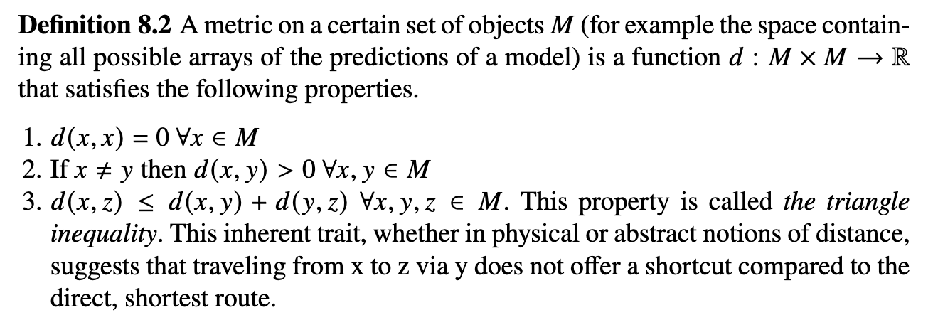
Metric (mathematical definition)
Fundamental Mathematical Concepts for Machine Learning in Science, Umberto Michelucci, Springer Nature (available in 2024)

Slide 4

Metrics – some examples: the MSE
One of the most known metric is the Mean Squared Error (MSE).
In general is used when comparing a set of predictions ${\hat{y}}_{i}$ with a set of expected values $y_{i}$ and is given by ($N$ is the total number of observations)

Slide 5
Metrics - Overview
Binary Classification
Multi-class Classification
Metric | Discussed Today | Metric | Discussed Today
Accuracy | ü | Accuracy | ü
Specificity | ü | Accuracy pro class
Sensitivity | ü
Balanced Accuracy | ü
F1 Score | ü
Area Under The Curve (AUC / Receiving Operating Curve) | ü
ü Confusion Matrix → Not really a metric (it contains multiple numbers)

Slide 6
Metrics - Overview
Binary Classification
Multi-class Classification
Metric | Discussed Today | Metric | Discussed Today
Accuracy | ü | Accuracy | ü
Specificity | ü | Accuracy pro class
Sensitivity | ü
Balanced Accuracy | ü
F1 Score | ü
Area Under The Curve (AUC / Receiving Operating Curve) | ü
ü Confusion Matrix → Not really a metric (it contains multiple numbers)

Slide 7
Confusion Matrix (binary classification)
Number of inputs classified as 0 and that have a true class of 0 (TRUE POSITIVES, TP)
Number of inputs classified as 1 and that have a true class of 0 (FALSE NEGATIVES, FN)
In the case of the perfect classifier:
FN = 0 and FP = 0
True Label 0
Number of inputs classified as 0 and that have a true class of 1 (FALSE POSITIVES, FP)
Number of inputs classified as 1 and that have a true class of 1 (TRUE NEGATIVES, TN)
True Label 1
Predicted Label 0
Predicted Label 1

Slide 8
Metrics - Overview
Binary Classification
Multi-class Classification
Metric | Discussed Today | Metric | Discussed Today
Accuracy | ü | Accuracy | ü
Specificity | ü | Accuracy pro class
Sensitivity | ü
Balanced Accuracy | ü
F1 Score | ü
Area Under The Curve (AUC / Receiving Operating Curve) | ü
ü Confusion Matrix → Not really a metric (it contains multiple numbers)

Slide 9
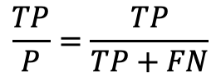
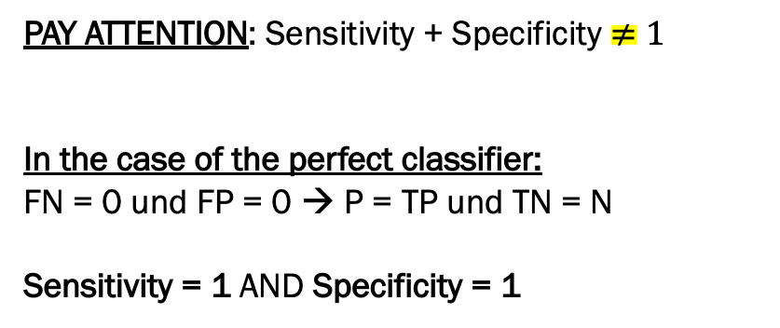


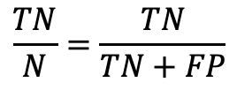
Sensitivity und Specificity
Sensitivity / Recall
True Positive Rate
$$\frac{TP}{P}=\frac{TP}{TP+FN}$$
How many of the cases in class 0 were correctly identified? "How many sick among all the sick have I identified?”
Specificity / selectivity
True Negative Rate
$$\frac{TN}{N}=\frac{TN}{TN+FP}$$
How many of the cases in Class 1 were correctly identified?
"How many healthy people among all healthy people have I identified?”
Confusion Matrix
PAY ATTENTION: Sensitivity + Specificity $≠1$
In the case of the perfect classifier:
FN = 0 und FP = 0 → P = TP und TN = N
Sensitivity = 1 AND Specificity = 1
TP
FN
$$P=TP+FN$$
True Label
FP
TN
$$N=TN+FP$$
Predicted Label

Slide 10
Metrics - Overview
Binary Classification
Multi-class Classification
Metric | Discussed Today | Metric | Discussed Today
Accuracy | ü | Accuracy | ü
Specificity | ü | Accuracy pro class
Sensitivity | ü
Balanced Accuracy | ü
F1 Score | ü
Area Under The Curve (AUC / Receiving Operating Curve) | ü
ü Confusion Matrix → Not really a metric (it contains multiple numbers)

Slide 11
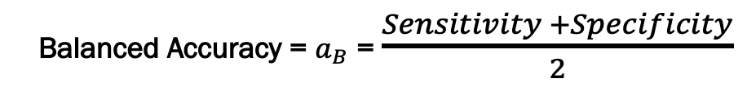
Balanced Accuracy
Sensitivity / Recall
True Positive Rate
$$\frac{TP}{P}=\frac{TP}{TP+FN}$$
How many of the cases in class 0 were correctly identified?
"How many sick among all the sick have I identified?"
Specificity / selectivity
True Negative Rate
$$\frac{TN}{N}=\frac{TN}{TN+FP}$$
How many of the cases in Class 1 were correctly identified?
"How many healthy people among all healthy people have I identified?”
Confusion Matrix
TP
FN
Balanced Accuracy = $a_{B}$ = $\frac{Sensitivity +Specificity}{2}$
$$P=TP+FN$$
True Label
FP
TN
$$N=TN+FP$$
Predicted Label

Slide 12
Metrics - Overview
Binary Classification
Multi-class Classification
Metric | Discussed Today | Metric | Discussed Today
Accuracy | ü | Accuracy | ü
Specificity | ü | Accuracy pro class
Sensitivity | ü
Balanced Accuracy | ü
F1 Score | ü
Area Under The Curve (AUC / Receiving Operating Curve) | ü
ü Confusion Matrix → Not really a metric (it contains multiple numbers)

Slide 13
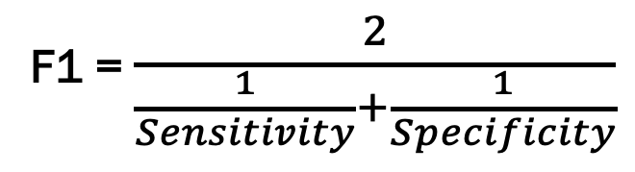
F1 Score
Sensitivity / Recall
True Positive Rate
$$\frac{TP}{P}=\frac{TP}{TP+FN}$$
How many of the cases in class 0 were correctly identified?
"How many sick among all the sick have I identified?"
Specificity / selectivity
True Negative Rate
$$\frac{TN}{N}=\frac{TN}{TN+FP}$$
How many of the cases in Class 1 were correctly identified?
"How many healthy people among all healthy people have I identified?”
Confusion Matrix
TP
FN
F1 = $\frac{2}{\frac{1}{Sensitivity}+\frac{1}{Specificity}}$
$$P=TP+FN$$
True Label
FP
TN
$$N=TN+FP$$
Predicted Label
* harmonic mean

Slide 14
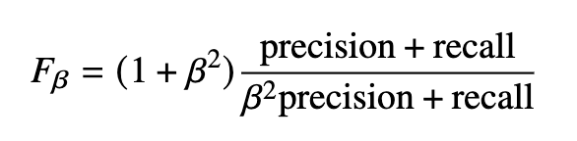
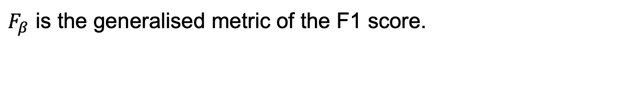
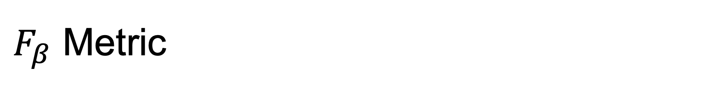
$F_{β}$ Metric
$F_{β}$ is the generalised metric of the F1 score.

Slide 15
Summary

Slide 16
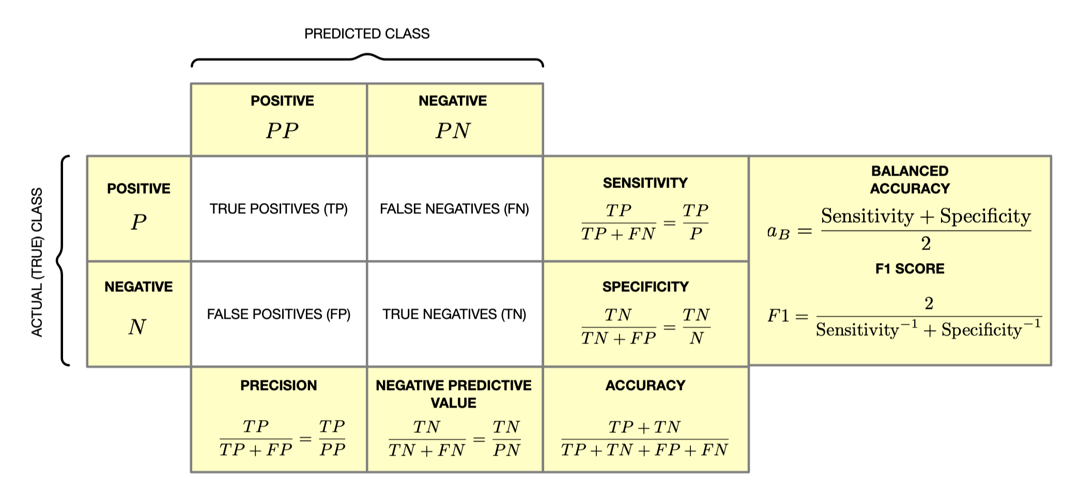
Summary – confusion matrix

Slide 17
Metrics - Overview
Binary Classification
Multi-class Classification
Metric | Discussed Today | Metric | Discussed Today
Accuracy | ü | Accuracy | ü
Specificity | ü | Accuracy pro class
Sensitivity | ü
Balanced Accuracy | ü
F1 Score | ü
Area Under The Curve (AUC / Receiving Operating Curve) | ü
ü Confusion Matrix → Not really a metric (it contains multiple numbers)

Slide 18
Receiving Operating Curve (ROC)
The ROC curve is a very important method for studying binary classification metrics. It is used to derive the Area Under the Cruve (AUC) metric.

Slide 19
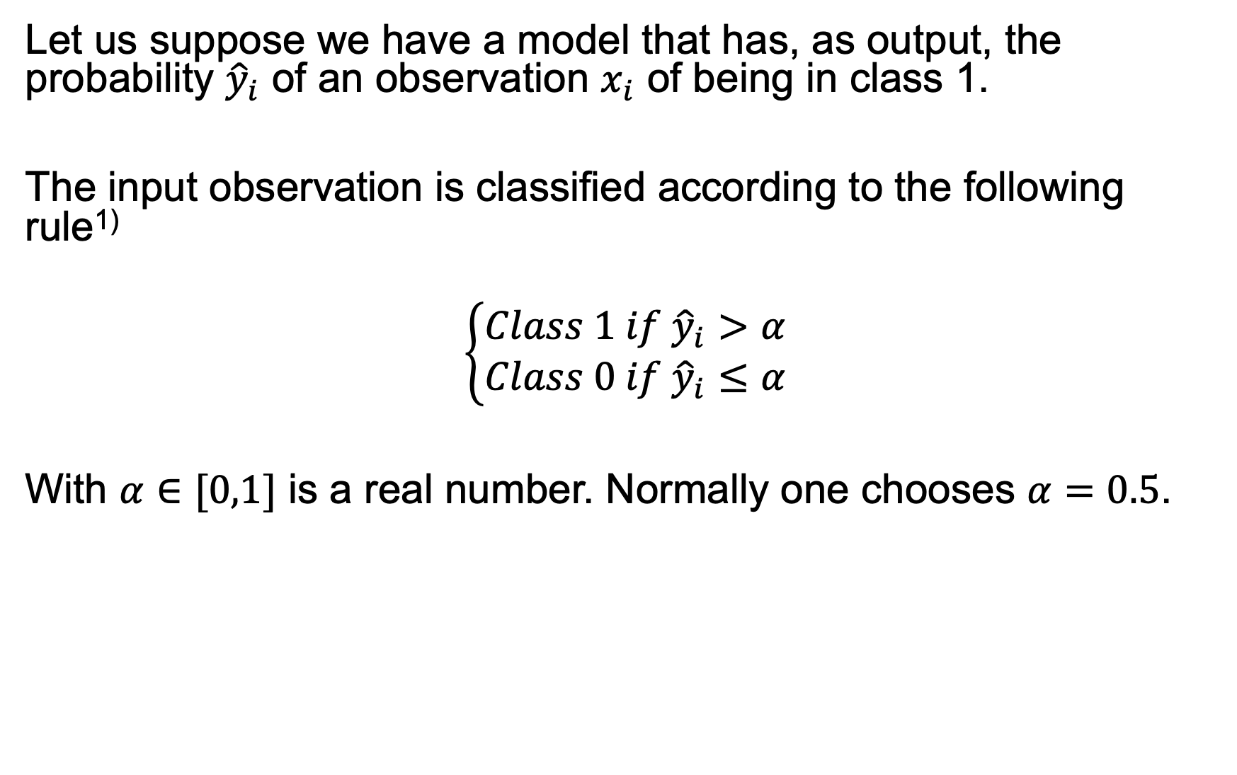
ROC Curve (I) - Derivation
Let us suppose we have a model that has, as output, the probability ${\hat{y}}_{i}$ of an observation $x_{i}$ of being in class 1.
The input observation is classified according to the following rule¹⁾
$$\left\{\begin{aligned}Class 1 if {\hat{y}}_{i}>α \\ Class 0 if {\hat{y}}_{i}≤α\end{aligned}\right.$$
With $α∈[0,1]$ is a real number. Normally one chooses $α=0.5$.
¹⁾ For the more mathematical savy of you, this is the translated Heaviside step function.

Slide 20
ROC Curve (II)
An ROC curve (receiver operating characteristic curve) is a graph showing the performance of a classification model at all classification thresholds. This curve plots two parameters:
True Positive Rate (TPR)
False Positive Rate (FPR)
How can we draw the curve? A model has only one value for TPR and FPR!
https://developers.google.com/machine-learning/crash-course/classification/roc-and-auc

Slide 21
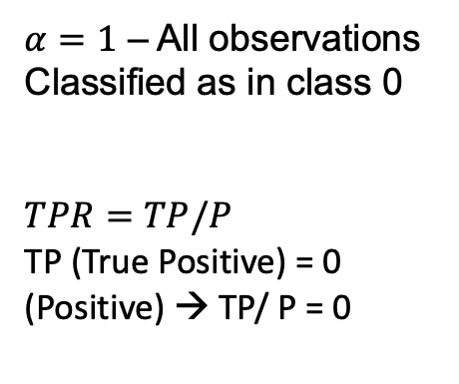
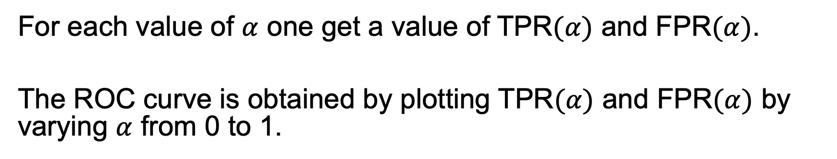

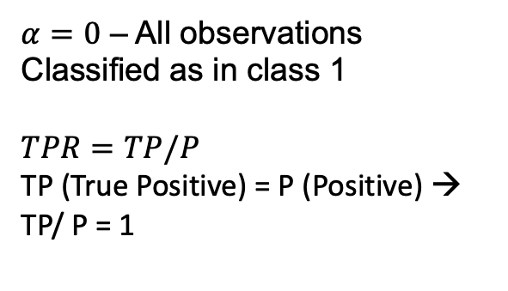
ROC Curve (III) - Derivation
For each value of $α$ one get a value of TPR$(α)$ and FPR$(α)$.
The ROC curve is obtained by plotting TPR$(α)$ and FPR$(α)$ by varying $α$ from 0 to 1.
$α=0$ – All observations
Classified as in class 1
$TPR=TP/P$ TP (True Positive) = P (Positive) → TP/ P = 1
1
TPR
$α=1$ – All observations
Classified as in class 0
$TPR=TP/P$ TP (True Positive) = 0 (Positive) → TP/ P = 0
A value of $α$ between 0 and 1
1
FPR

Slide 22
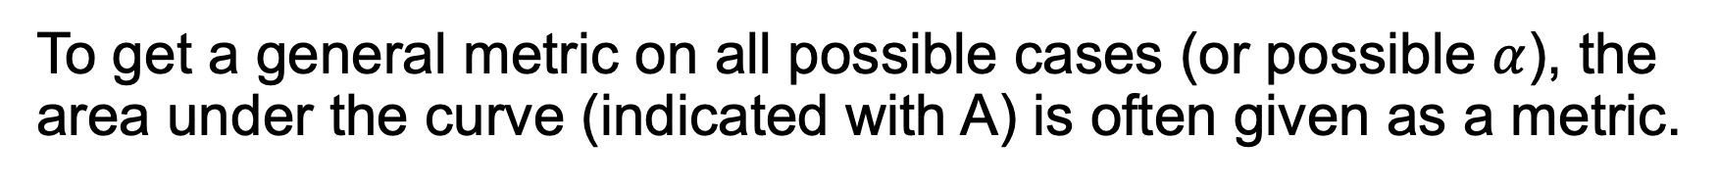
ROC Curve (IV) – AUC (Area Under the Curve)
To get a general metric on all possible cases (or possible $α$), the area under the curve (indicated with A) is often given as a metric.
$α=0$ – All observations
Classified as in class 1
$TPR=TP/P$ TP (True Positive) = P (Positive) → TP/ P = 1
1
TPR
$α=1$ – All observations
Classified as in class 0
$TPR=TP/P$ TP (True Positive) = 0 (Positive) → TP/ P = 0
A
A value of $α$ between 0 and 1
1
FPR

Slide 23
ROC Curve (V) – AUC (Area Under the Curve) – Probability Interpretation
The AUC is the probability that given one randomly selected input in class 1 (positives) and one randomly selected negative input in class 0 (negatives), the model (the classifier) will be able to tell which is which.

